Slide 1
Fresh Food App
Group 27 members: Wasay Ahmed (wahmed9), Christian Gutierrez (cgutie38), Jordan Nguyen (jtn3), Natalie Reyes (nreyes28)

Slide 2
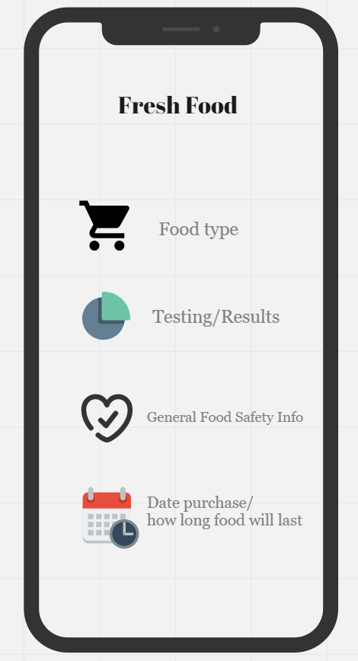
Section 1 Project Overview
The Fresh Food application will let the user know if food has gone bad by analyzing the chemical components of the odor released by food.
Chemical makeup of the odor is read by external odor sensors and the data is sent to the app which will calculate edibility and estimate days til inedible depending on the type of food.
Removes the guesswork of deciding whether food has gone bad.

Slide 3
Section 2 The Purpose of the Project
Save money by solving the following issues:
1. Reduce food waste.
2. Increase food safety.
3. Reduce the emissions of greenhouse gasses.

Slide 4
Section 3 The Scope of the Work
Currently most food sold have sell-by and expiration dates that are not entirely accurate.
Work Partitioning:
1. User: Sensor Setup
2. User: Food Setup
3. App: Sensor Measurements and Analysis

Slide 5
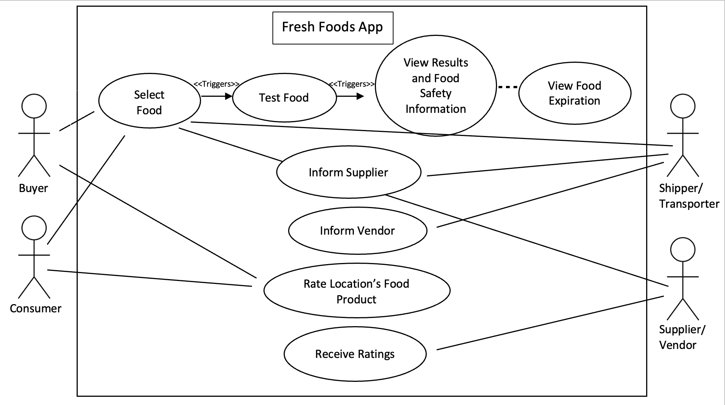
Section 4 The Scope of the Product

Slide 6



Section 5 Stakeholders
Clients
Use the app to determine how fresh the products are.
Key hands-on users: Consumers that shop for fresh produce, meat, and dairy products.
Secondary users: include vendors or suppliers of the food that is to be sold such as grocery stores.
Least important: producers of the food.
Customers:
Users of this application will have the responsibility of…
Inputting correctly product before testing.
Choose from a variety of food types and categories from dairy, products, meat, fruits, and vegetables.
Learn what the detection results mean.
Check log that was created that estimates expiration via calendar.
Team:
Other Stakeholders
Legal experts: Contracts and smooth process
Marketing team; make the product attractive to potential users.
Financial advisor: manage money and budget accordingly.
Food chemist: study chemical changes in stored foods.
Maintenance
Developers: test performance for accuracy
Engineers: perform tasks to the UI/database
Both: update product for the whole duration of the product's life.

Slide 7




Section 6 Mandated Constraints
Solution Constraints and Implementation:
Updated database: products to test.
Sort: alphabetized order to respective categories.
After: choose food item and test for gasses such as:
Methane, hydrogen sulfide, Noxious solanine gas, and ammonia
Available on android and iOS
  Downloadable by a wider variety of people.
  Needs to be evaluated for app store.
Applications and Software:
Sharing API: Connect and share data to google calendar or with others when getting gas detection results.
Smartphone: Needed by the client in order to have access to the application.
Login API: Allow clients to easily login using gmail accounts.
Schedule and Budget Constraints:
To distribute the app we must have consumers who are able and ready to utilize it into their routine.
shopping for food at a grocery store
Employees maintaining own products
Distributor of the food.
Doesn’t require much besides expenses related to the development or infrastructure of the application.
Workplace environment:
The product is developed to be easily accessible due to versatility
Can be used at the clients home and even accessible when grocery shopping at the grocery store.

Slide 8
Section 7 Naming Conventions and Definitions
Definitions in the context of the Fresh Food App:
Buyer: An individual, shopper, or business that is planning on purchasing or has purchased produce, meat, or dairy product(s).
Consumer: An individual who is about to eat or has eaten produce, meat, or dairy product(s).
Shipper/Transporter: An individual, or employee of a business who ships/transports produce, meat, or dairy products from the supplier to the intended destination.
Vendor: Farms, companies, restaurants, business owners, markets, stores, employees, or anyone who sells fresh produce, meat, or dairy products.
Supplier: Farms, companies, restaurants, business owners, markets, stores, employees, or anyone who supplies fresh produce, meat, or dairy products to a buyer.

Slide 9
Section 8 Relevant Facts and Assumptions
Every year, an estimated 1 in 6 Americans (or 48 million people) get sick, 128,000 are hospitalized, and 3,000 die from foodborne diseases.
Each year, 108 billion pounds of food is wasted in the United States. That equates to 130 billion meals and more than $408 billion in food thrown away each year.
Food wastage is responsible for around 6% of total global greenhouse gas emissions.
The share of Americans that own a smartphone is now 85%(2021)
We assume that all food that rots will emit a traceable odor. If not, we can list specific foods for the user that cannot be checked by the app.
We assume that the users can set up the odor sensors correctly to get accurate samples.

Slide 10
References
https://www.cdc.gov/foodsafety/food-poisoning.html
https://www.feedingamerica.org/our-work/our-approach/reduce-food-waste
https://ourworldindata.org/food-waste-emissions
https://www.pewresearch.org/internet/fact-sheet/mobile/

